Slide 1



Xtreme Reading
Strategies
Knowledge
Habits of learning
Notes:
Xtreme Reading teaches adolescent struggling readers the strategies, habits of learning, and knowledge regarding reading and literacy that are required to thrive in the 21st century. It has been designed to meet the needs of middle and high school students who read at approximately a 4th grade level but still fall at least 2 grade levels behind in their reading.

Slide 2


Slide #2
Is designed for middle school or high school students.
Read at a 4th grade level but still fall at least 2 grade levels behind in their reading.

Slide 3


Slide #3
It’s based on a toolbox of STRATEGIES
Good readers are active and engaged while reading.
To Help Students Get Plugged Into Learning
Notes:
Xtreme Reading is comprised of foundational reading and motivation strategies.
Research has taught us that strategies are often the key to student success and motivation. Nothing motivates students more than success, and strategies will boost the performance of students resulting in academic success.

Slide 4
#4: Xtreme Reading Spiral Curriculum
Notes:
The curriculum of Xtreme Reading follows a spiral design. Strategies are introduced one a time with each new strategy layered on top of the previous ones. By the end of the course, students have not only learned 8 new strategies, but have also learned how to integrate all of these in a fluid and strategic approach to reading.

Slide 5
The Xtreme Reading Model
Reading Core
Metacognition
Class Management
OUTCOMES
• Improved reading
comprehension
• Motivation for reading
• Increased hope
• Success in academically challenging classes
Decoding
Vocabulary
Word Recognition
=
Comprehension
Fluency
Community Learning Skills
Motivation
Notes:
The core of Xtreme Reading includes word level strategies that help students decode, recognize words, build vocabulary, and read more fluently. It also includes 3 powerful comprehension strategies. In addition, the curriculum includes components that help teachers build a positive learning community based on high expectations.
As students experience success in reading and in their academically challenging classes, they are more motivated to read and more motivated to learn.

Slide 6
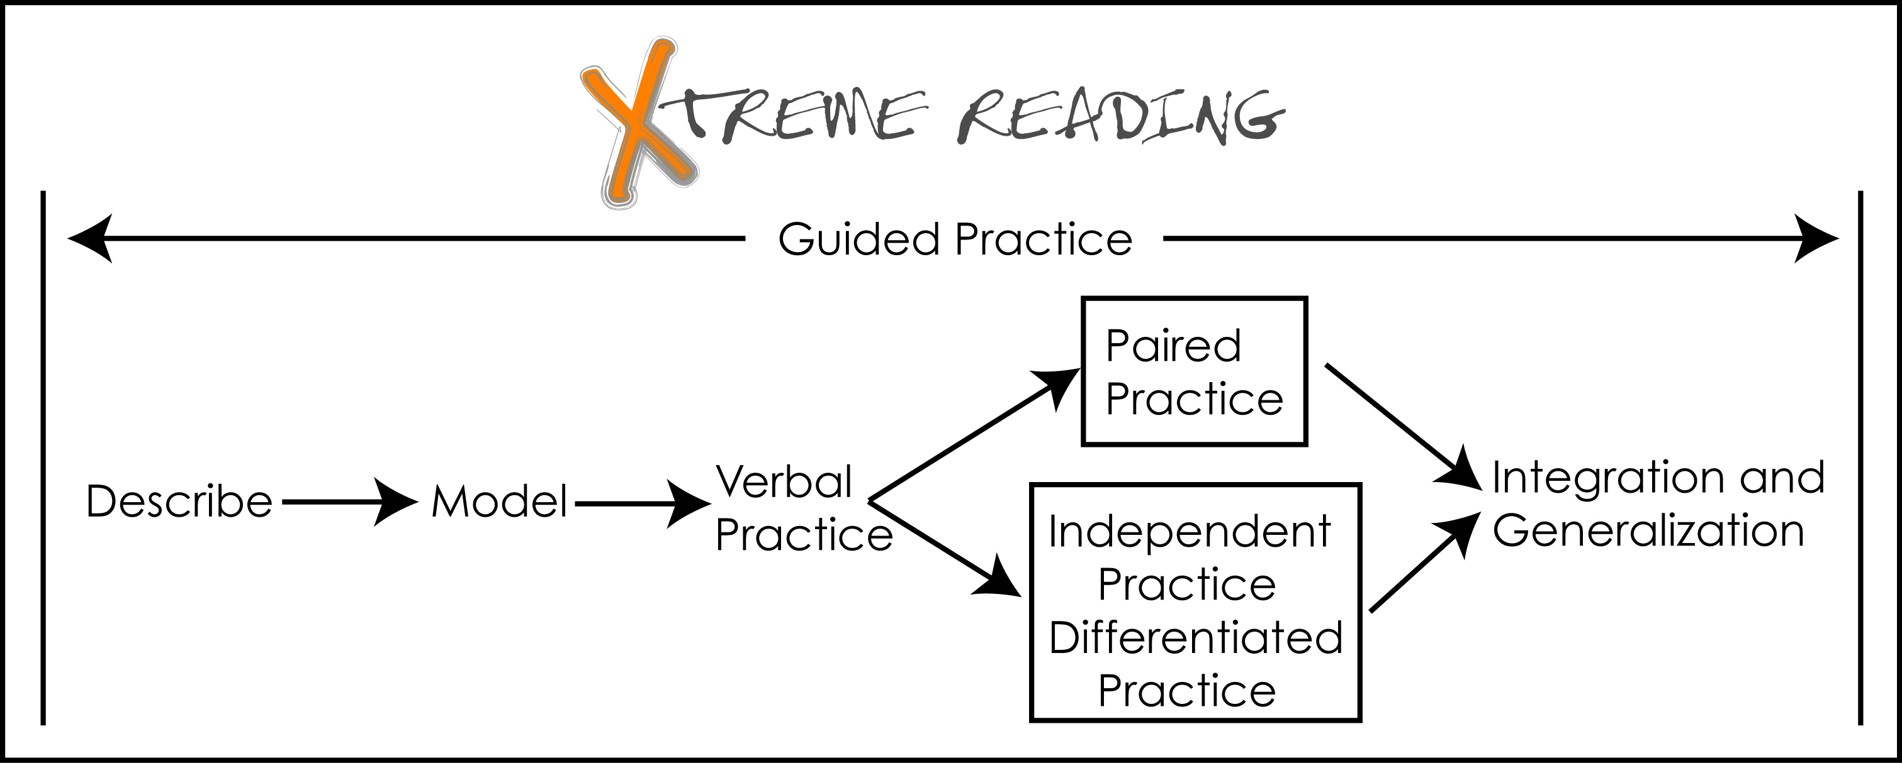
Slide #6: Guided Practice
Notes:
Xtreme Reading entails explicit instruction in each strategy. Teachers describe the strategy, model it for the students, practice the steps of the strategy verbally with students and then provide multiple practice activities with leveled reading passages. Through it all teachers monitor students’ progress and provide meaningful feedback. Students then practice combining or integrating the new strategy with previous ones and generalizing their new reading strategies in other school-related texts and passages.

Slide 7
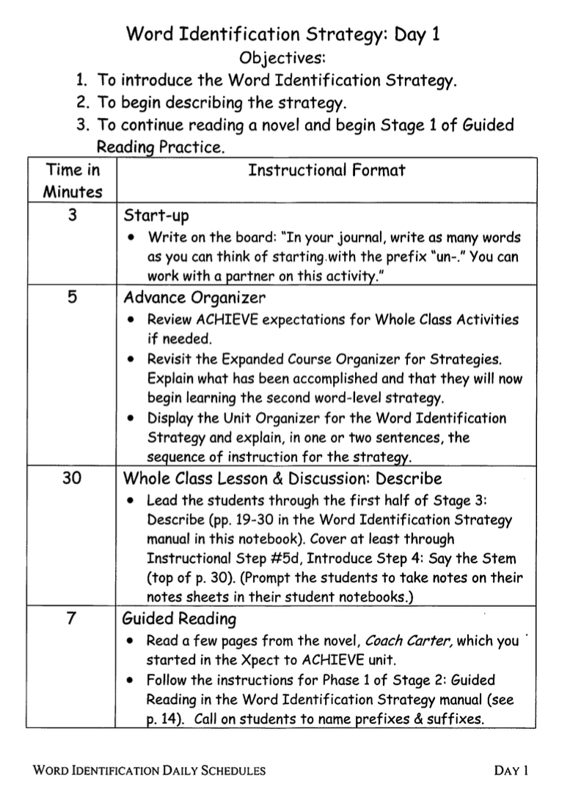
Daily
Schedules are provided for each Strategy Unit
Notes:
Daily Schedules are provided for each strategy unit. Daily schedules include a start-up activity, an advance organizer, strategy instruction and guided reading.

Slide 8

The working parts of Xtreme form a comprehensive program.
It is instruction that is specially designed to help students integrate and generalize strategies within and outside school.
Notes:
The various components or working parts of Xtreme Reading are specially designed to help students become strong readers within school and in other areas of their lives.

Slide 9

Slide #9
Notes:
Let’s take a peek at grade equivalency gains in one North Carolina school over a 3-year period.

Slide 10
Slide #10: Bar Graph TOSCRF
3 Years of Grade Equivalent Gain Scores in One District
on the TOSCRF
Notes:
This chart represents gains made over a 3-year period. In the school year 2013-2014, two schools in this district implemented Xtreme Reading. They are represented by the blue bars on the chart. These schools gave the Test of Silent Contextual Reading Fluency as a pretest and posttest. The blue bars indicate the grade equivalency growth for each school as measured by the test. As you can see, the results are 3.7 years of growth in one school and 2.5 years of growth in the other school over the course of the one year program. (See complete notes on script.)

Slide 11
Slide #11: Bar Graph GRADE
3 Years of Grade Equivalent Gain Scores in One District
on the GRADE
Notes:
The Group Reading Assessment and Diagnostic Evaluation, more commonly known as the GRADE assessment, was also given as a pre and posttest to the same schools during that 3-year period. The results show that on average students demonstrated more than one year of growth – and in some cases more than two years of growth. Students who had traditionally showed very little gains in the past were becoming readers!

Slide 12
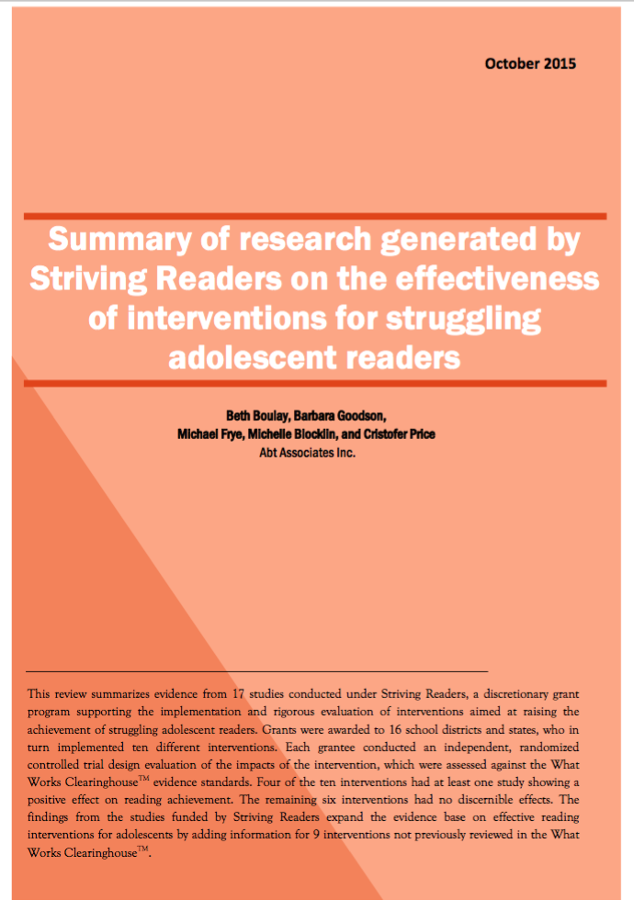
Slide #12: Striving Readers Initiative
Information on the Striving Readers Initiative
http://www.ies.ed.gov/ncee/pubs/20164001
Notes:
You can find information about some of the research behind Xtreme Reading in an article posted on the Institute of Education Sciences website. The article was published by What Works Clearinghouse and provides a summary of evidence from 17 studies conducted under the Striving Readers grant.

Slide 13

Information on
Evidence-based reading programs for
Middle and High Schools http://www.evidenceforessa.org
Notes:
You can also read more about Xtreme Reading on the evidenceforessa website that provides a list of evidence-based reading programs for middle and high schools.

Slide 14

Slide #14: XR is
Xtreme Reading Is…
Notes:
To sum it up, Xtreme Reading provides an opportunity for students to become strong readers and stronger students. It lays the groundwork for success in school and opens the door to success in life.

Slide 15

Slide #15: XR website
www.sim.ku.edu

Slide 16
For More Information, Contact:
University of Kansas Center for Research on Learning
email:
simpd@ku.edu
Or call:
785-864-4780

Slide 17
Thank you!
Many thanks to Pam Leitzell for her work on the slide deck and narrative.

